Slide 1
WHY WE STARTED PROJECTMARK
Revenue Growth
Construction Companies continue to struggle with CRM software
Marketing
Sales
Technical
Marketing Team
Company Leaders & BD Execs
Project Managers
Manage Historical Data
Proposals
Pursuit tracking
Relationship Management
Business Development
Task Management
Project Planning
Inefficient Data MGMT Processes
Lack of adoption amongst users (especially the seller doers)
Everyone in their own data silos

Slide 2
OUR
SOLUTION
Revenue Growth
An intuitive CRM platform for the entire team
Marketing
Sales
Technical
Marketing Manager
Company Leaders & BD Execs
Project Managers
Manage Historical Data
Proposals
Pursuit tracking
Relationship Management
Business Development
Task Management
Project Planning
Streamlined Data Management
Simple to use
Drives collaboration

Slide 3
WHY WE’RE DIFFERENT
We’ve Focused on 3 Key Areas to Standout
Being fast to implement (Minutes not months!)
Being flexible to customize and report from
Being simple to store and harness data

Slide 4
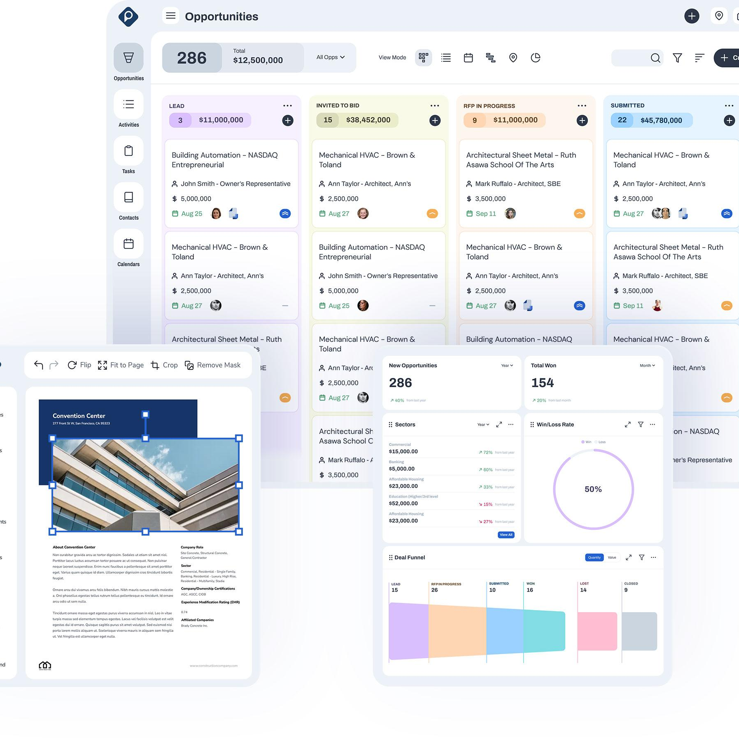
Our Mission
Our mission is to be an integral part of why construction companies win work by providing intuitive software that:
- Fosters innovation
- Enables Data driven decision making
- Cultivates stronger relationships

Slide 5
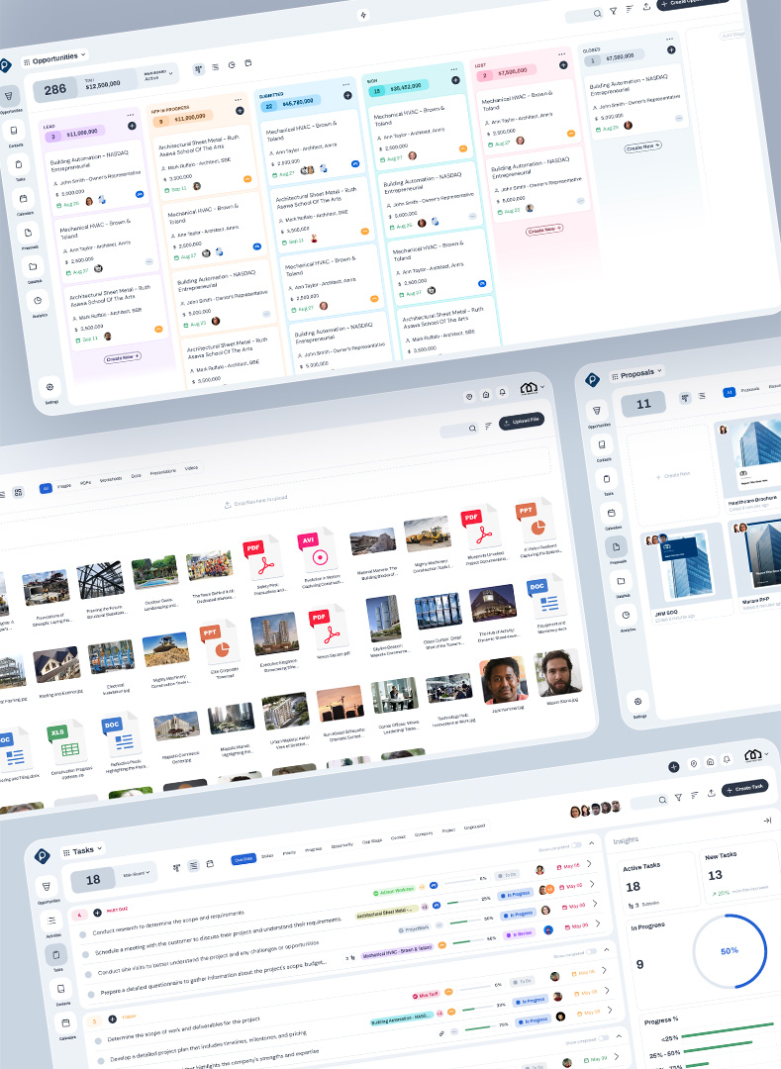
Client Stories

Slide 6
CASE STUDY
A Little Bit About KCI Construction
Key Outcomes
KCI Construction
Founded in 1922, KCI Construction has grown into a leading construction firm known for its self-performing capabilities in general, concrete, and carpentry construction. They offer comprehensive construction services as a general contractor, construction manager, and design-builder. KCI Construction prides itself on quality, safety, and client satisfaction, serving a wide range of markets including schools, hospitals, highways, and bridges.
Implementing ProjectMark brought about significant changes at KCI Construction:
- Improved Tracking and Decision-Making: The platform enabled the team to create new opportunities quickly and use that information for internal decision-making.
- Enhanced Collaboration: It provided a single location to store client contacts, share leads on opportunities, and keep notes for others to reference.
- Ease of Use: Learning to use ProjectMark was very easy, making it straightforward for the team to adopt.
- Valuable Reporting: The reporting function simplified the process and made it easy to generate custom reports, providing clear insights during bid meetings.
KCI Construction found that the improved reporting capabilities
KCI Construction Streamlines Lead Management with ProjectMark
Overcoming “Vanilla” CRM Challenges
KCI Construction needed a solution to accurately track lead opportunities, their sources, and the time spent in pursuit. Their previous CRM system was cumbersome and difficult to navigate, making it hard for the team to efficiently generate high-quality marketing materials and RFP responses. Reporting was particularly problematic, often leading to errors and delays. The system also lacked easy customization, which was crucial for creating tailored proposals and marketing collateral. KCI Construction sought a user-friendly solution that could handle the specific demands of the construction industry.
Read Full Case Study
“
Transitioning to ProjectMark
ProjectMark has been instrumental in accurately tracking lead opportunities and their sources. The user-friendly interface and the construction-friendly terminology have made it easy for our team to adopt and utilize effectively."
KCI Construction selected ProjectMark because of its intuitive interface and robust features that are tailored to the unique demands of the construction industry. The landing pages are intuitive, and the information is easy to read through. ProjectMark facilitated a smooth transition from their previous CRM system, with easy data input and customization options that significantly improved workflow efficiency. The platform enabled KCI Construction to accurately track lead opportunities, sync and sort contacts, and utilize historical data to create proposal materials quickly and efficiently. The user-friendly nature of ProjectMark allowed team members to adapt quickly, minimizing downtime and maximizing productivity.
Stacie Ramos
PRECONSTRUCTION MANAGER

Slide 7
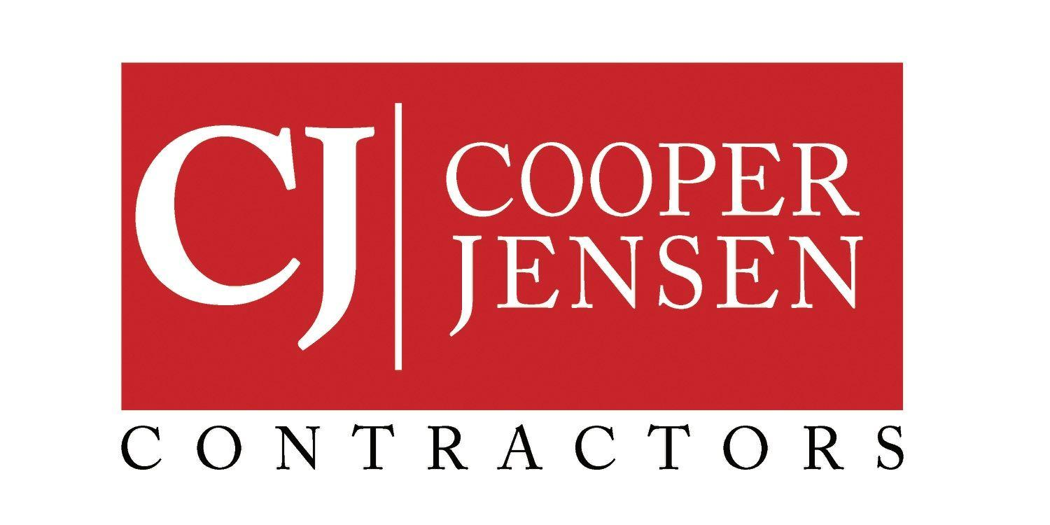
CASE STUDY
About Cooper Jensen
Productivity Surge from the Get-Go
Cooper Jensen
Cooper Jensen, established in 2015, is a dynamic commercial general contractor boasting decades of collective team experience. With a specialization in ground-up and finish out projects across various sectors including office, retail, day care, and hospitality, CooperJensen operates on the bedrock principles of construction: "Build it right, care about your clients, and stay on track." Renowned for their reliability and commitment to excellence, they offer owners peace of mind, ensuring each project is executed flawlessly from inception to completion.
According to Mark Tatom, Business Development Manager at Cooper Jensen, ProjectMark CRM stands out for its intuitive interface and ease of use. The step-by-step processes make learning effortless, empowering users to maximize productivity from day one. Offering personalized support and responsiveness, ProjectMark CRM aligns seamlessly with Cooper Jensen's objectives, providing a tailored solution for the construction industry.
How ProjectMark CRM Propelled Cooper Jensen to Unmatched Efficiency
Read Full Case Study
When a Generic CRM Doesn’t Cut It
Despite their industry prowess, CooperJensen encountered constraints with their generic CRM solution. Recognizing the need for a tailored approach, they sought a transformative solution offering flexibility and adaptability to streamline pipeline management. Additionally, comprehensive analytics were vital to empower senior management with insights into business health. Understanding the organizational impact of transitioning systems, Cooper Jensen prioritized a tool tailored specifically for construction, from a provider that’s personable and responsive to their needs in providing a personalized onboarding experience.
“
ProjectMark is a great construction CRM solution that can grow with us as the industry advances."
Mark Tatom
BUSINESS DEVELOPMENT MANAGER
The Key to Unmatched Efficiency
Embracing ProjectMark CRM, Cooper Jensen revolutionized their approach to task management, ensuring proactive and responsive engagement with every opportunity and contact. By setting specific follow-up dates and tracking opportunities with defined next steps, they prevent tasks from slipping through the cracks, reinforcing their commitment to client care and project efficiency. ProjectMark CRM has enhanced their accountability and efficiency, offering heightened pipeline visibility and increased opportunities.

Slide 8
CASE STUDY
A Little Bit About Henley Construction
Transformational Outcomes
Henley Construction
Established in 1964, Henley Construction is a family-owned contractor specializing in commercial and educational facilities. Serving the Washington, DC Metro area, they focus on quality, proactive solutions, and personal attention, offering services such as pre-construction, design/build, construction management, and general contracting.
Implementing ProjectMark brought about significant changes at Henley Construction. The time needed to manage their CRM and streamline business development workflows was drastically reduced from several days to just a few hours, enabling the team to respond to more opportunities quickly. ProjectMark proved to be a game-changer, elevating the quality of their data management.
The platform also facilitated better team collaboration by allowing real-time access and updates to project information, minimizing miscommunications, and ensuring alignment. Learning to use ProjectMark was straightforward, and the streamlined process improved workflow and productivity. With all relevant information stored in ProjectMark, assembling RFP responses and other documents became exponentially faster, enabling the team to focus on other critical tasks.
Henley Construction found the reporting function particularly valuable, as it simplified the process and made it easy to generate custom reports. The improved reporting capabilities provided
Henley Construction Achieves Exceptional Business Development Efficiency with ProjectMark
The Need for Enhanced Data Management
Henley Construction faced significant challenges in their existing data management and marketing workflows. Their previous CRM system was cumbersome and difficult to navigate, making it difficult for the team to efficiently generate high-quality marketing materials and manage their pipeline. Reporting was particularly problematic, often leading to errors and delays. Additionally, the existing system did not support easy customization, which was crucial for creating tailored materials. They needed a solution that was not only user-friendly but also powerful enough to handle the specific demands of the construction industry.
Read Full Case Study
Migrating to ProjectMark
“
Henley Construction turned to ProjectMark for a fit-to-purpose CRM solution with an intuitive interface and robust features designed specifically for the construction industry. ProjectMark provided a seamless transition from their previous CRM system, with easy data input and customization options that significantly improved workflow. The platform enabled Henley Construction to draft detailed RFP responses, create professional resumes, and develop high-quality marketing materials quickly and efficiently. The ease of use of ProjectMark allowed team members to adapt rapidly, minimizing downtime and maximizing productivity. The ability to store all relevant information in one centralized location further streamlined their processes, making the assembly of finished documents faster and more accurate.
ProjectMark has been a game-changer for us. It’s user-friendly and customizable, making navigation and reporting easy. The onboarding was smooth, and weekly training got us up and running quickly. I highly recommend making the switch to ProjectMark—you won't regret it."
Tracy Quick
MARKETING & BUSINESS DEVELOPMENT

Slide 9
“
“
“
Easy-to-use CRM to help your team drive deals to closure. Customer Service goes out of their way to make sure your implementation goes smoothly.
Project Mark is a Great Solution for General Contractors. I love how easy it is to create a RFP response proposal book!"
The user-friendly interface and the construction-
friendly terminology have made it easy for our team to adopt and utilize effectively."
Sherry Heaton-Rylko
Hayley Sumner
Stacie Ramos
PRESIDENT/CEO
DIRECTOR OF MARKETING
PRECONSTRUCTION MANAGER
Trusted by 25 General Contractors across the country

Slide 10
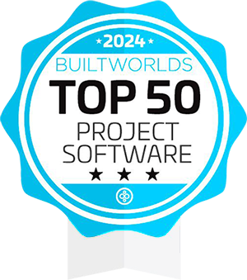
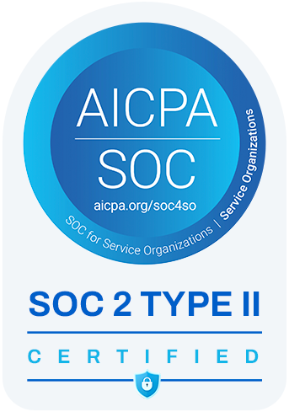
Industry Recognized
ProjectMark has been listed as one of the Top 50 Project Software for the construction industry in the Customer Relationship Management Category.
ProjectMark has been recognized as one of the 50 most promising startups of 2024 that are redefining the Contech ecosystem.
Bartlett Cocke General Contractors Signs Enterprise Partnership with ProjectMark
ProjectMark is proud to announce its strategic partnership with Bartlett Cocke General Contractors, a leading General Contractor in the construction industry. This collaboration aims to enhance Bartlett Cocke's ability to win projects, streamline workflows, and foster stronger client relationships.
ProjectMark comes highly recommended by its customers, earning an impressive 4.9 out of 5 rating on G2, the most trusted software review platform in the market.
ProjectMark achieved SOC 2 Type 2 certification, a rigorous cybersecurity compliance framework established by the American Institute of Certified Public Accountants (AICPA).
Read Article

Slide 11
Key Product Highlights

Slide 12
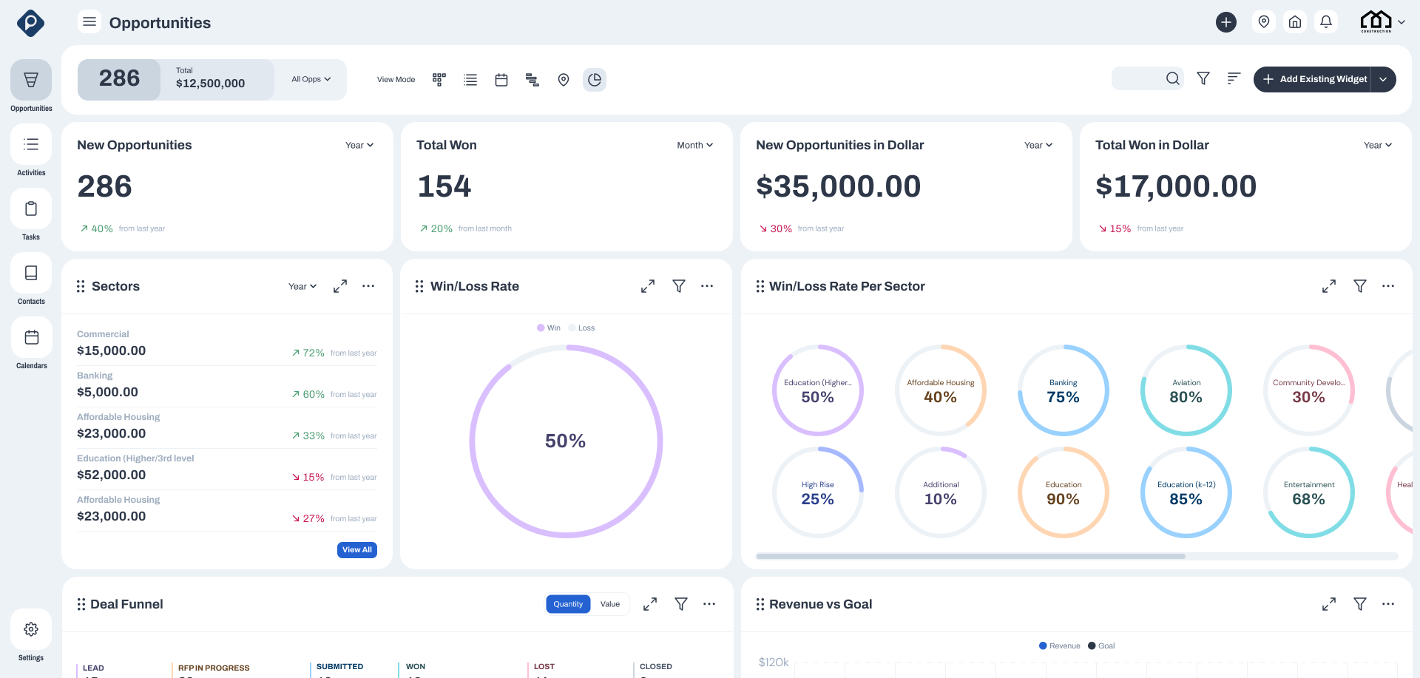
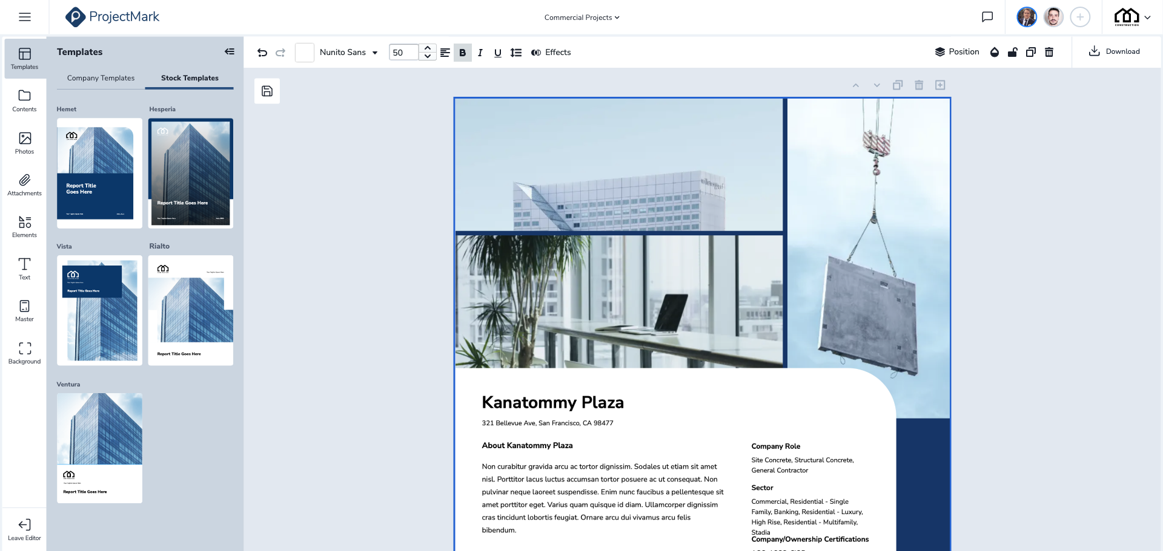
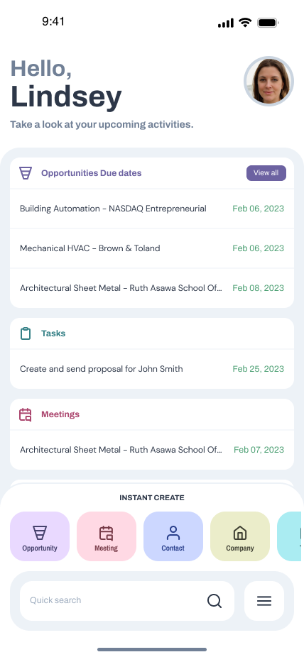
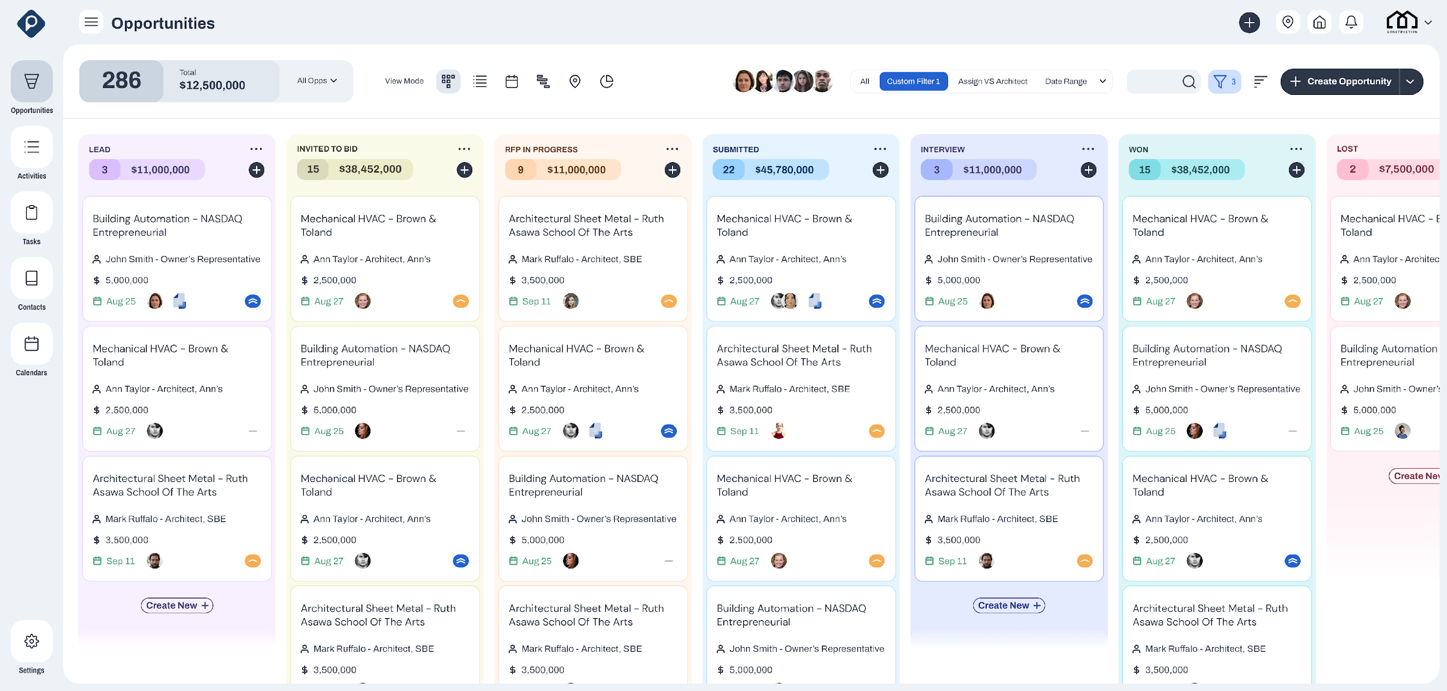
A Platform That Wears As Many Hats as Your Team Does
Utilization
Analytics for the Pre-Con Team
Company Performance Analytics
Proposals & CMS for the Marketing & BD Team
Proposal Generator
Mobile for BD
CRM Pipeline
CRM Mobile
Pipeline View for the Entire Team

Slide 13
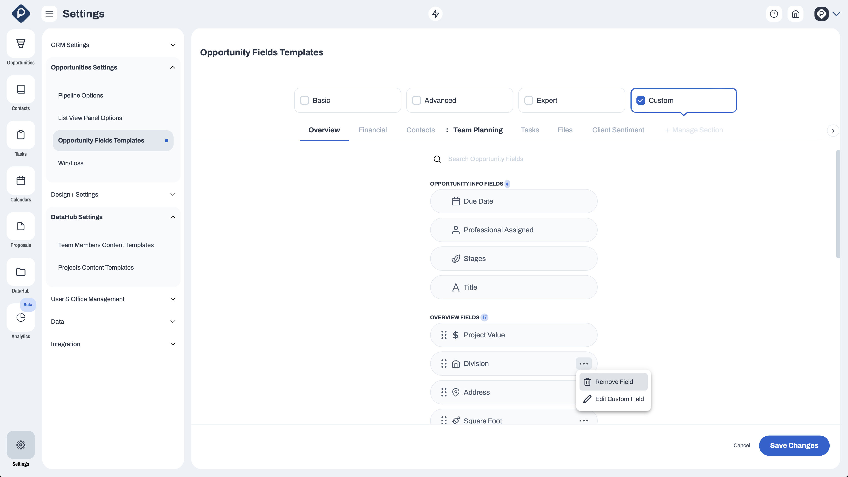
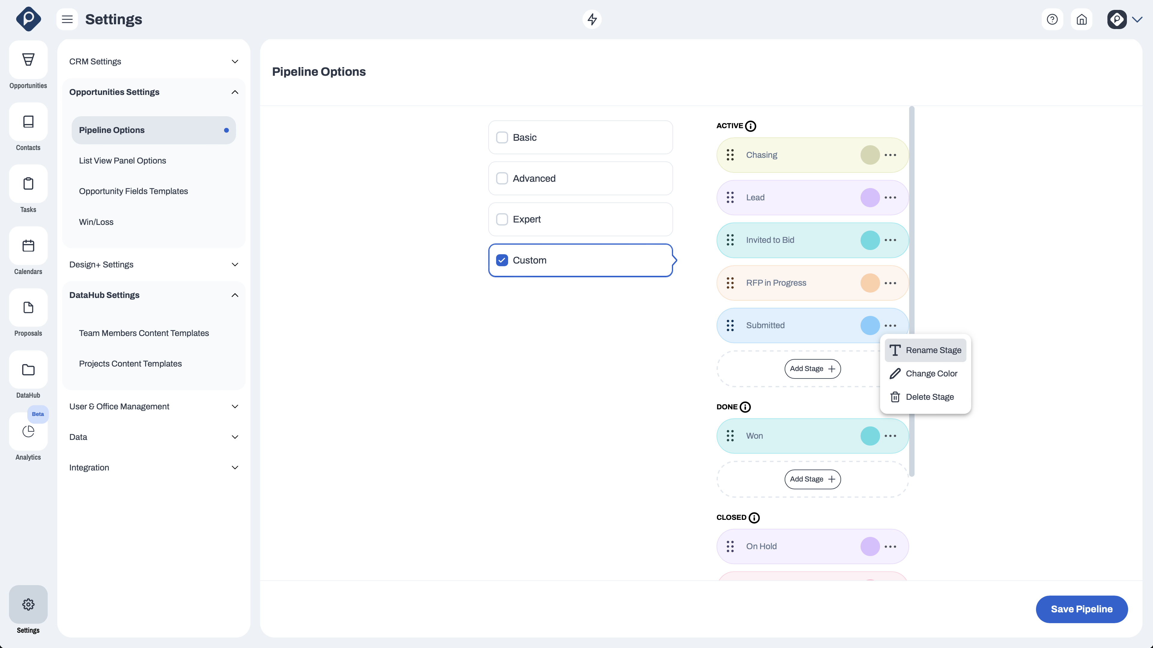
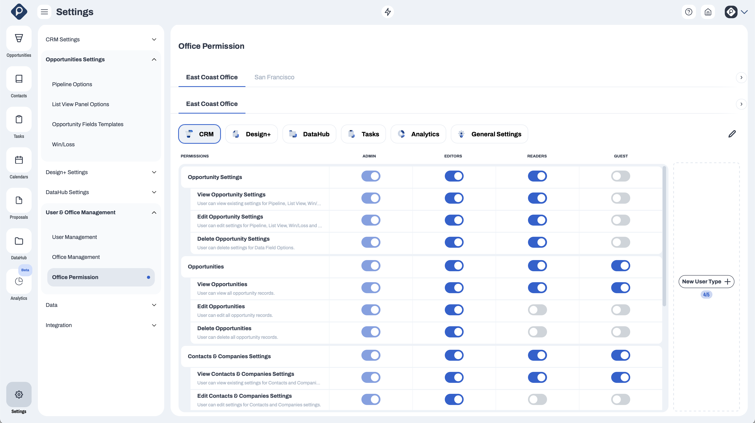
Platform Customization
SETTINGS
Sales Pipeline Customization (Kanban & List View)
Opportunities Overview Customization
Opportunities Financial Info/table Customization
Contacts & Companies Panel Customization
Contacts & Companies Fields Customization
Projects Sections and Fields Customization
Team Members Sections and Fields Customization
Proposals Builder Fields Customization
User Access Customization
Integrations Customization
Watch How To Video

Slide 14
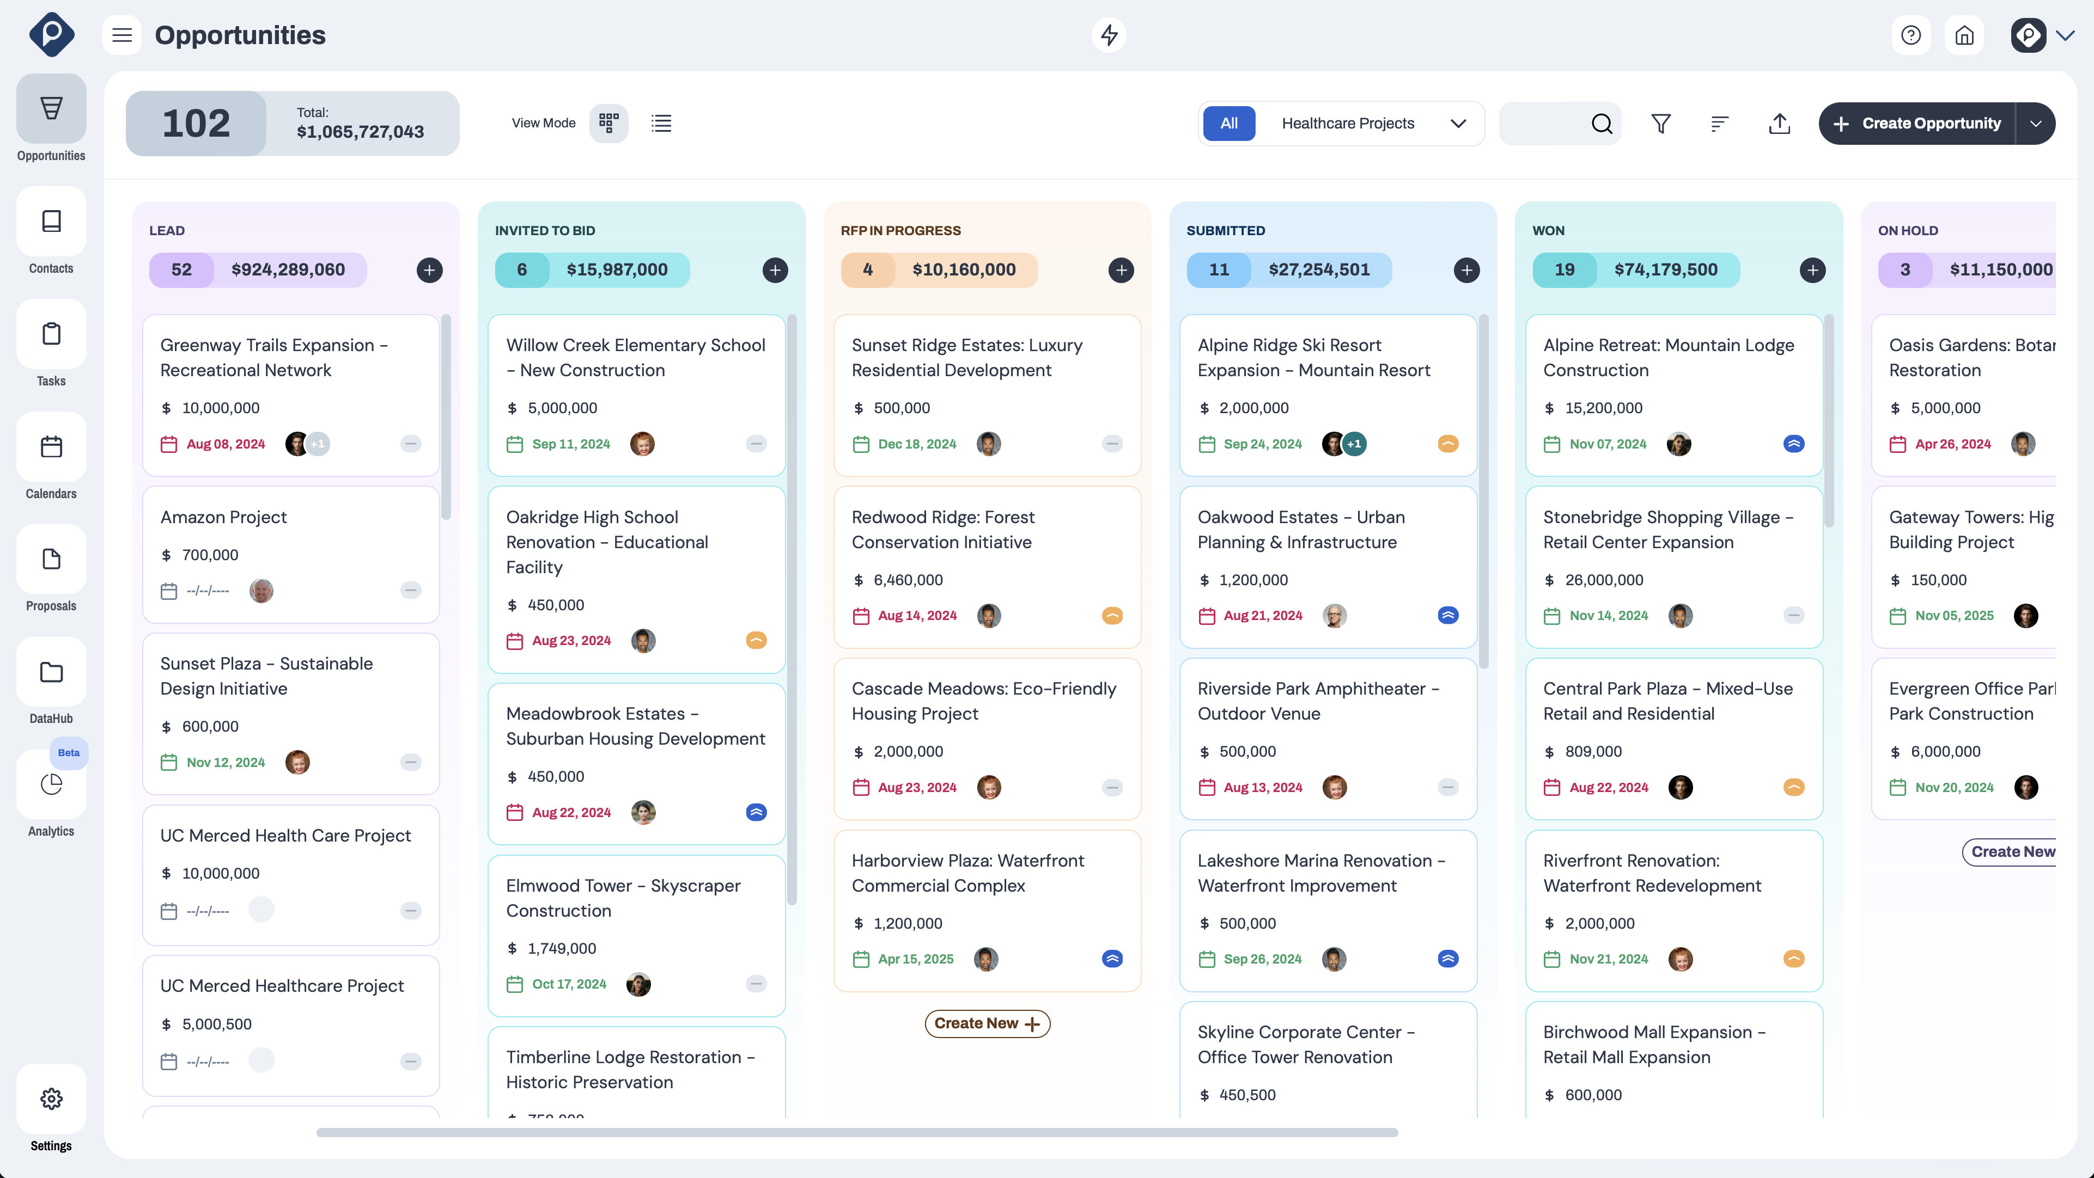
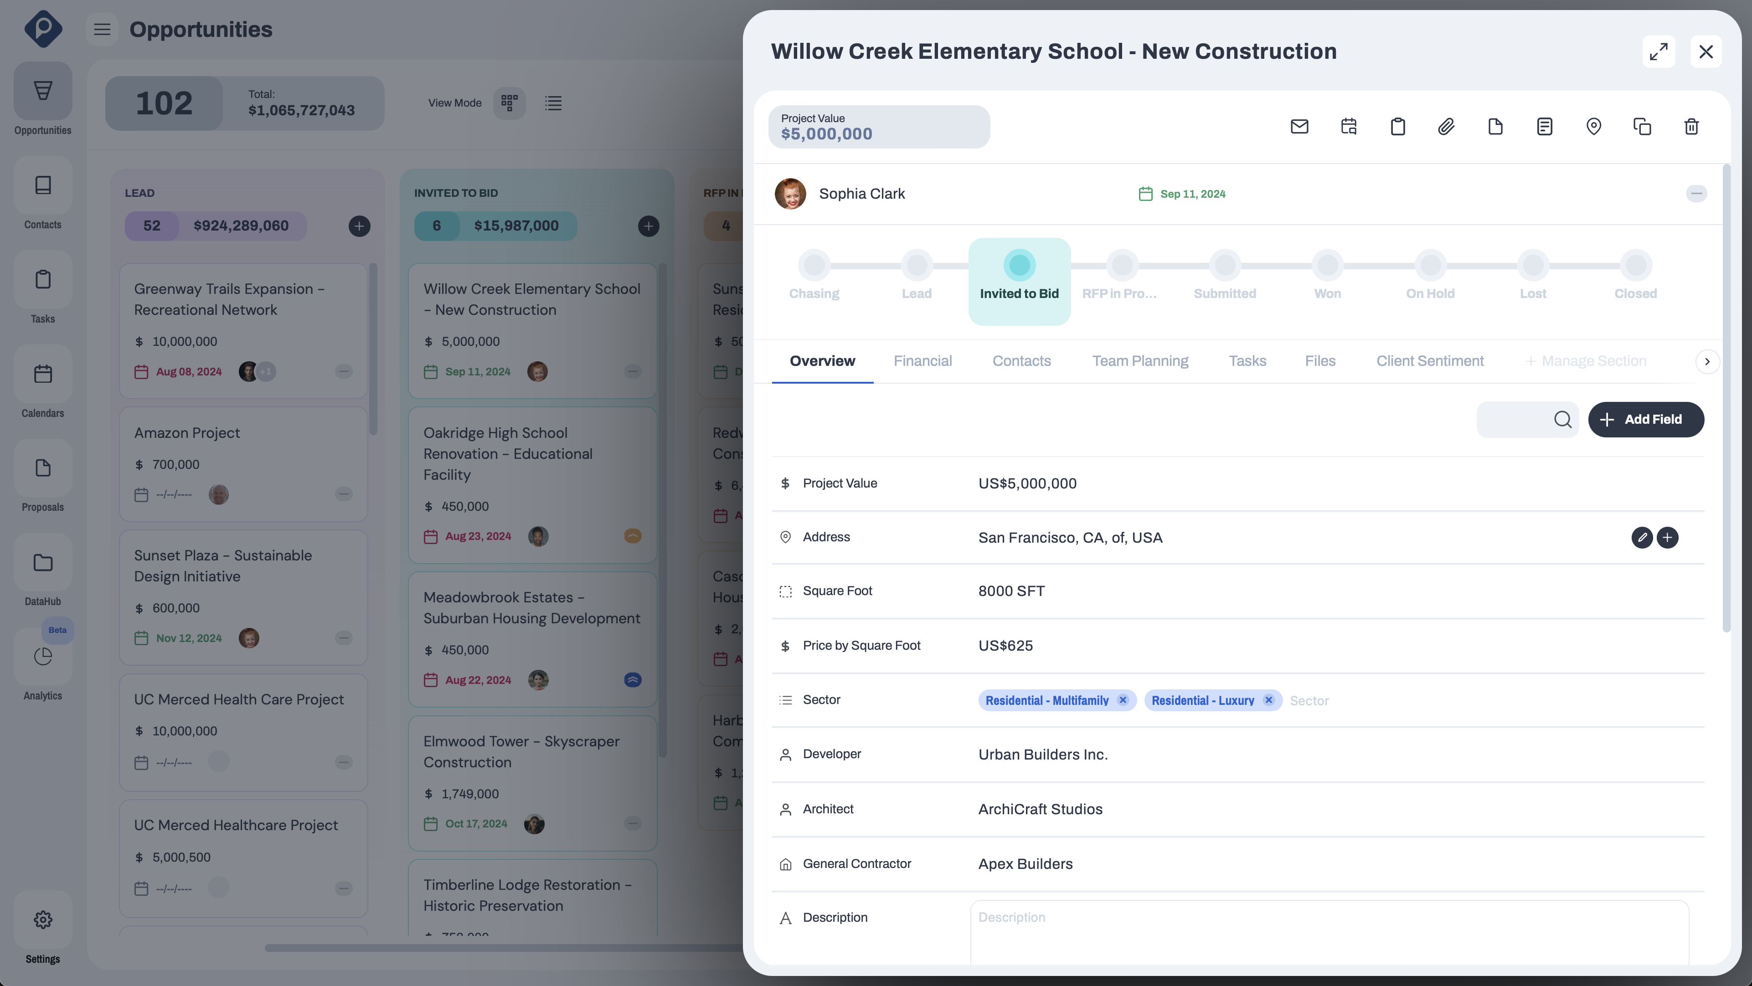
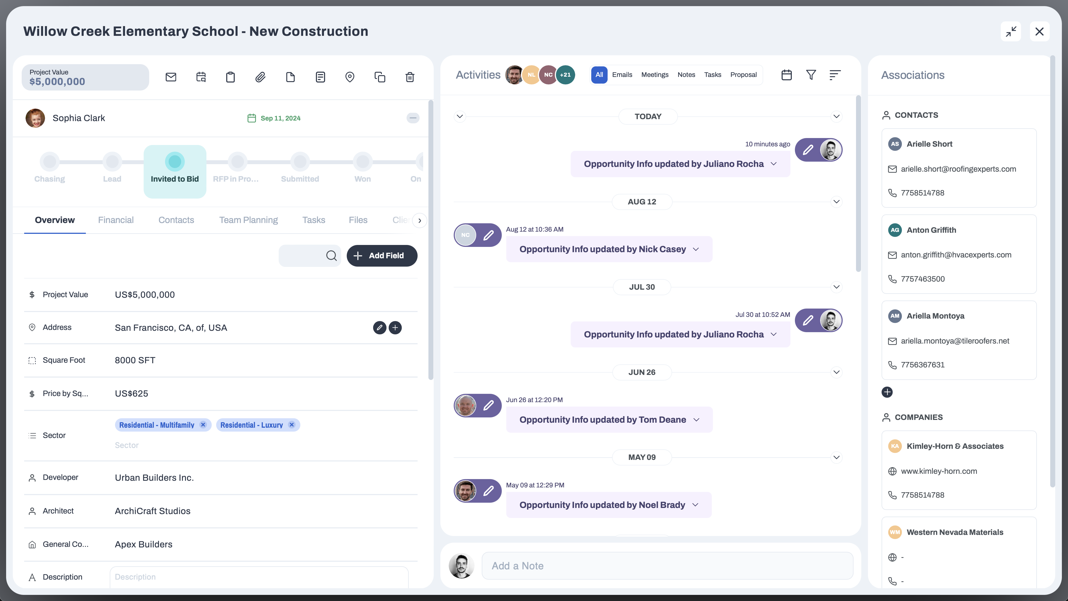
Opportunities Management
Kanban & List View
Filters, Sorting Options, and Saved Views
Overview Info
Financial Table
Contacts Management
Team Planning
Files & Associations
Tasks Management
Custom Content Tabs & Custom Fields
Activities Logs
Watch How To Video

Slide 15
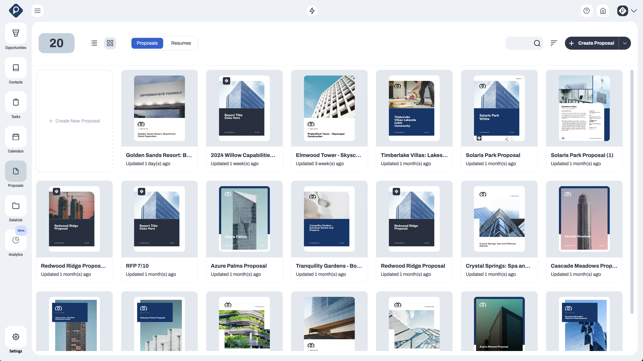
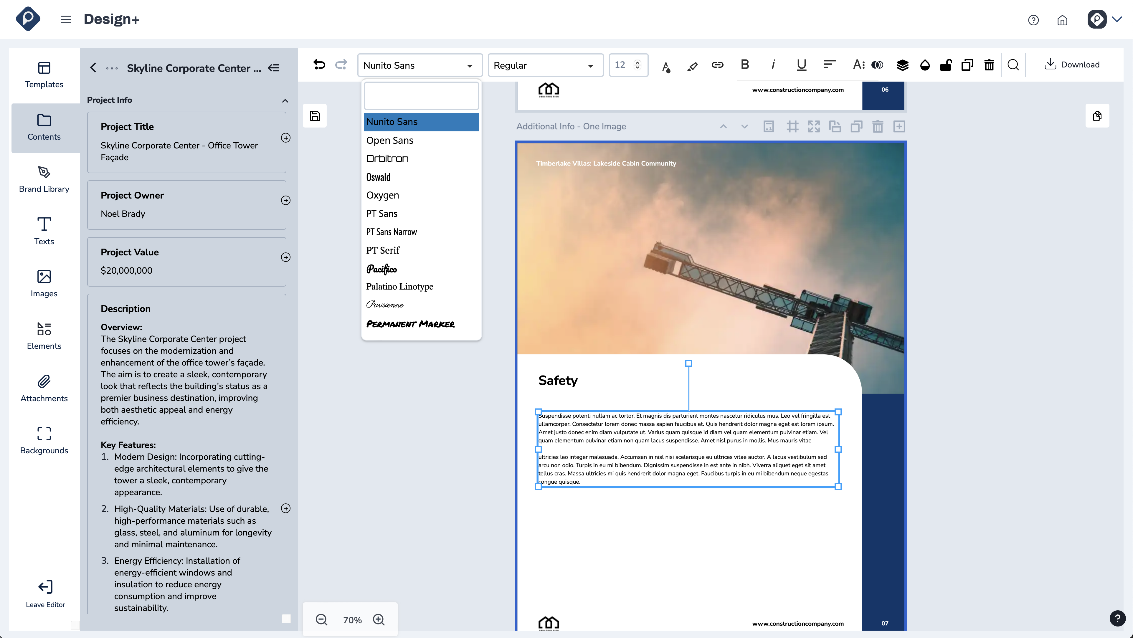
Proposals Management
Unlimited Proposal Creation
Unlimited Template Creation
Company Info
Projects Info
Team Members Info
Images & Elements Management
Attachments Management
Headers & Footers
Auto-Pagination
Custom Fonts
Watch How To Video

Slide 16
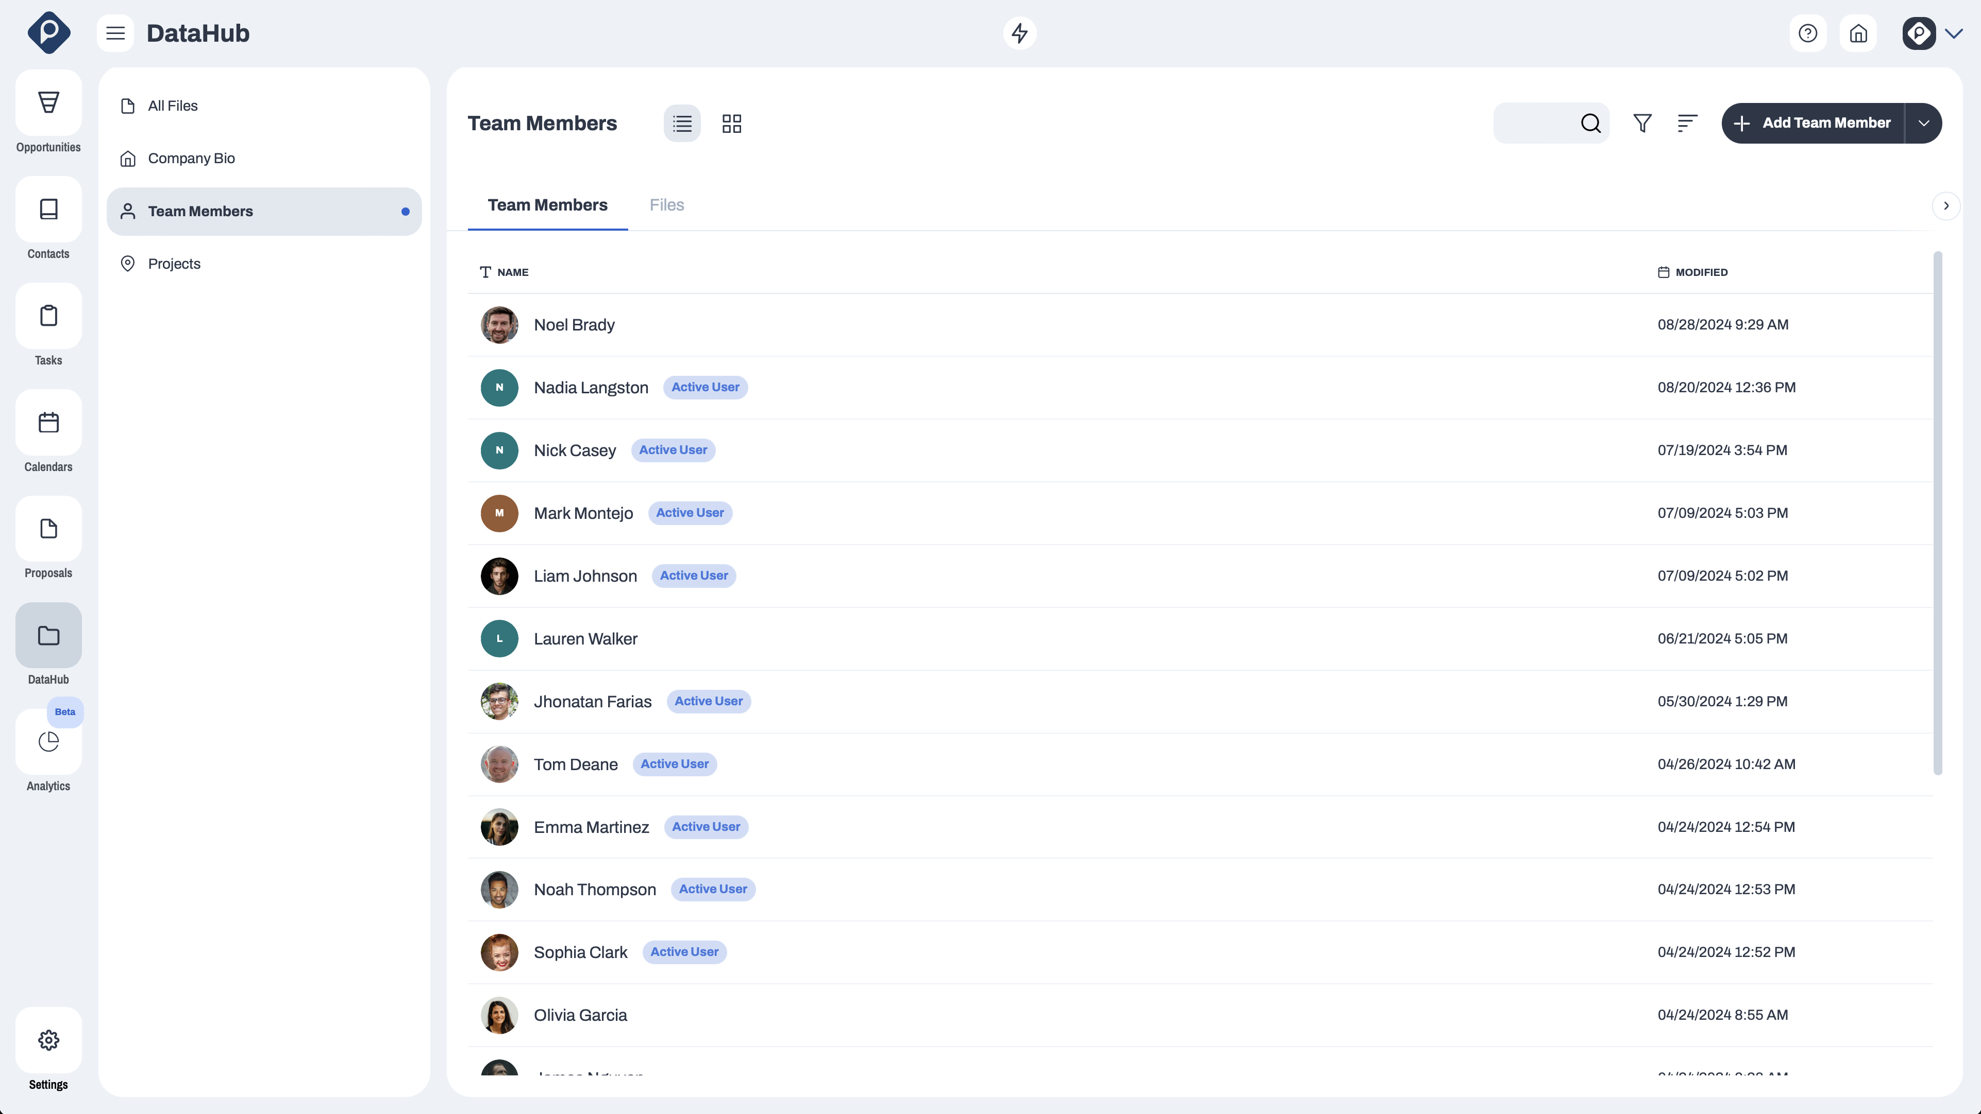
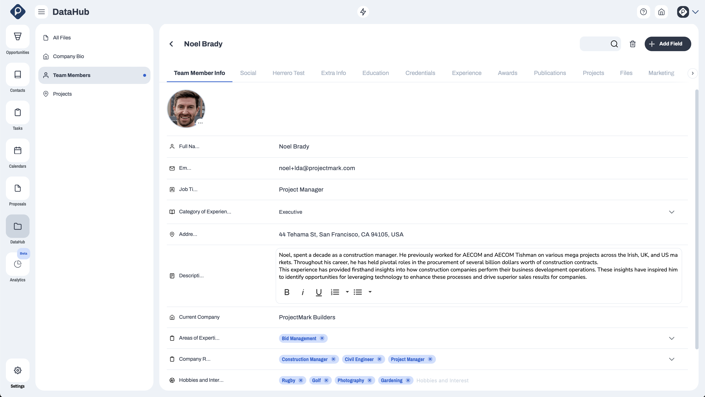
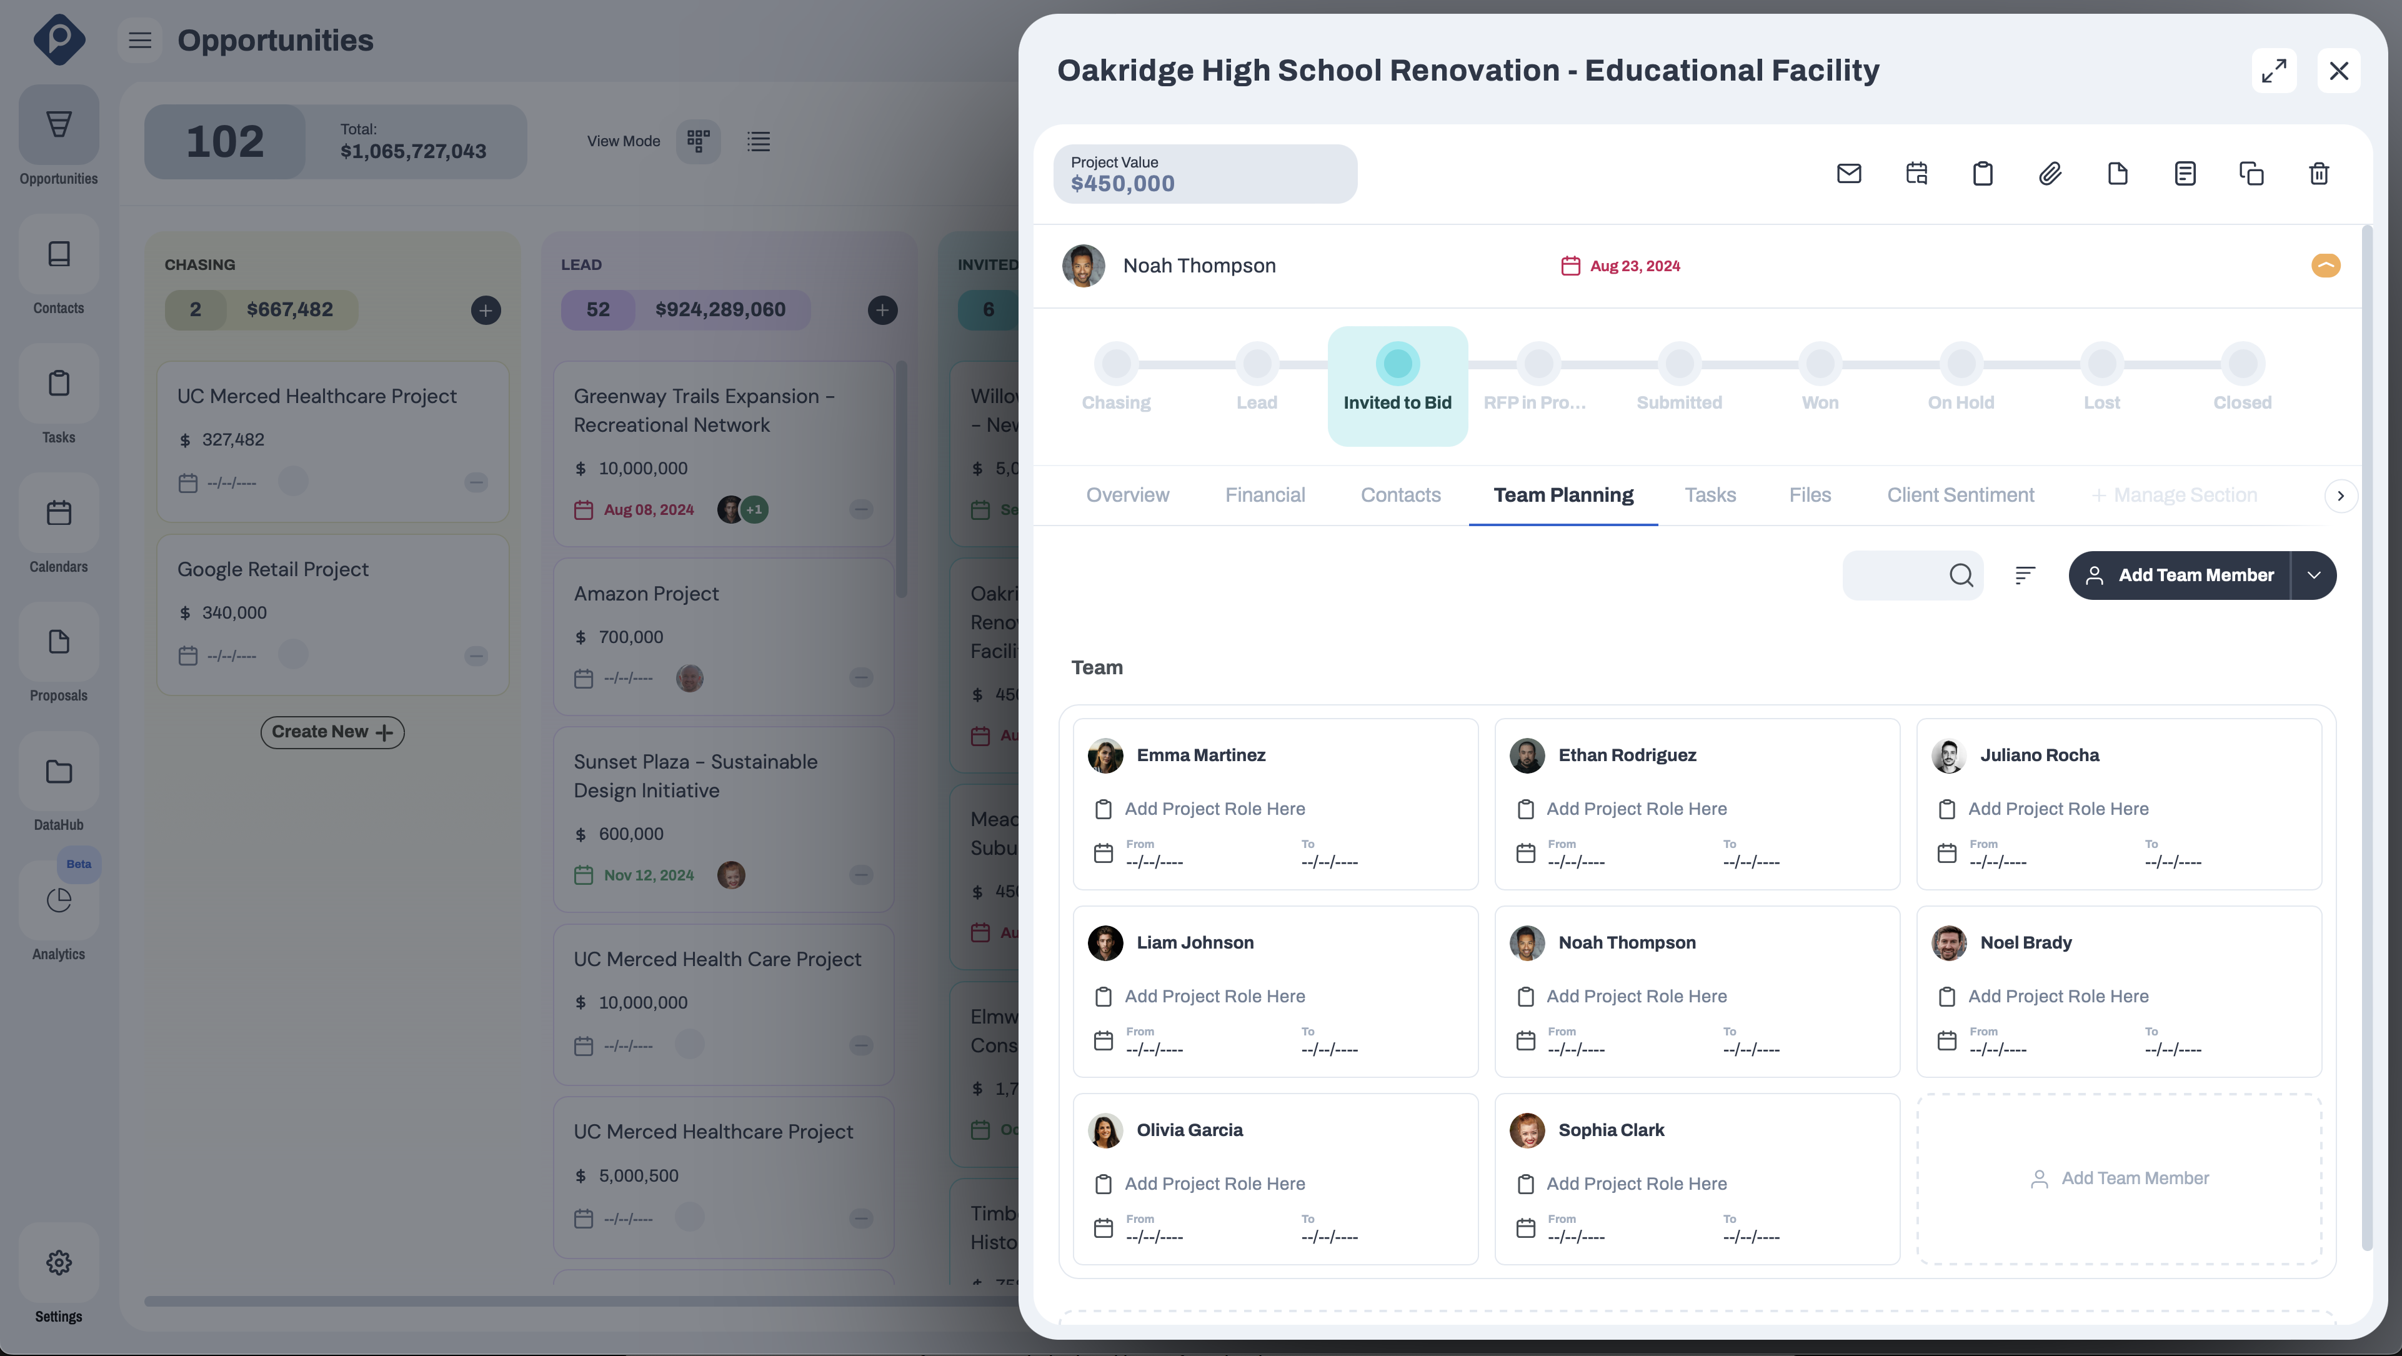
Team Management
Unlimited Team Members Creation
Filters, Sorting Options, and Saved Views
Overview Section to Store Members' Main Info
Experiences, Credentials, Education Sections, and More
Custom Content Tabs & Custom Fields
Projects Association
Opportunities Association
Files
Resumes
Watch How To Video

Slide 17
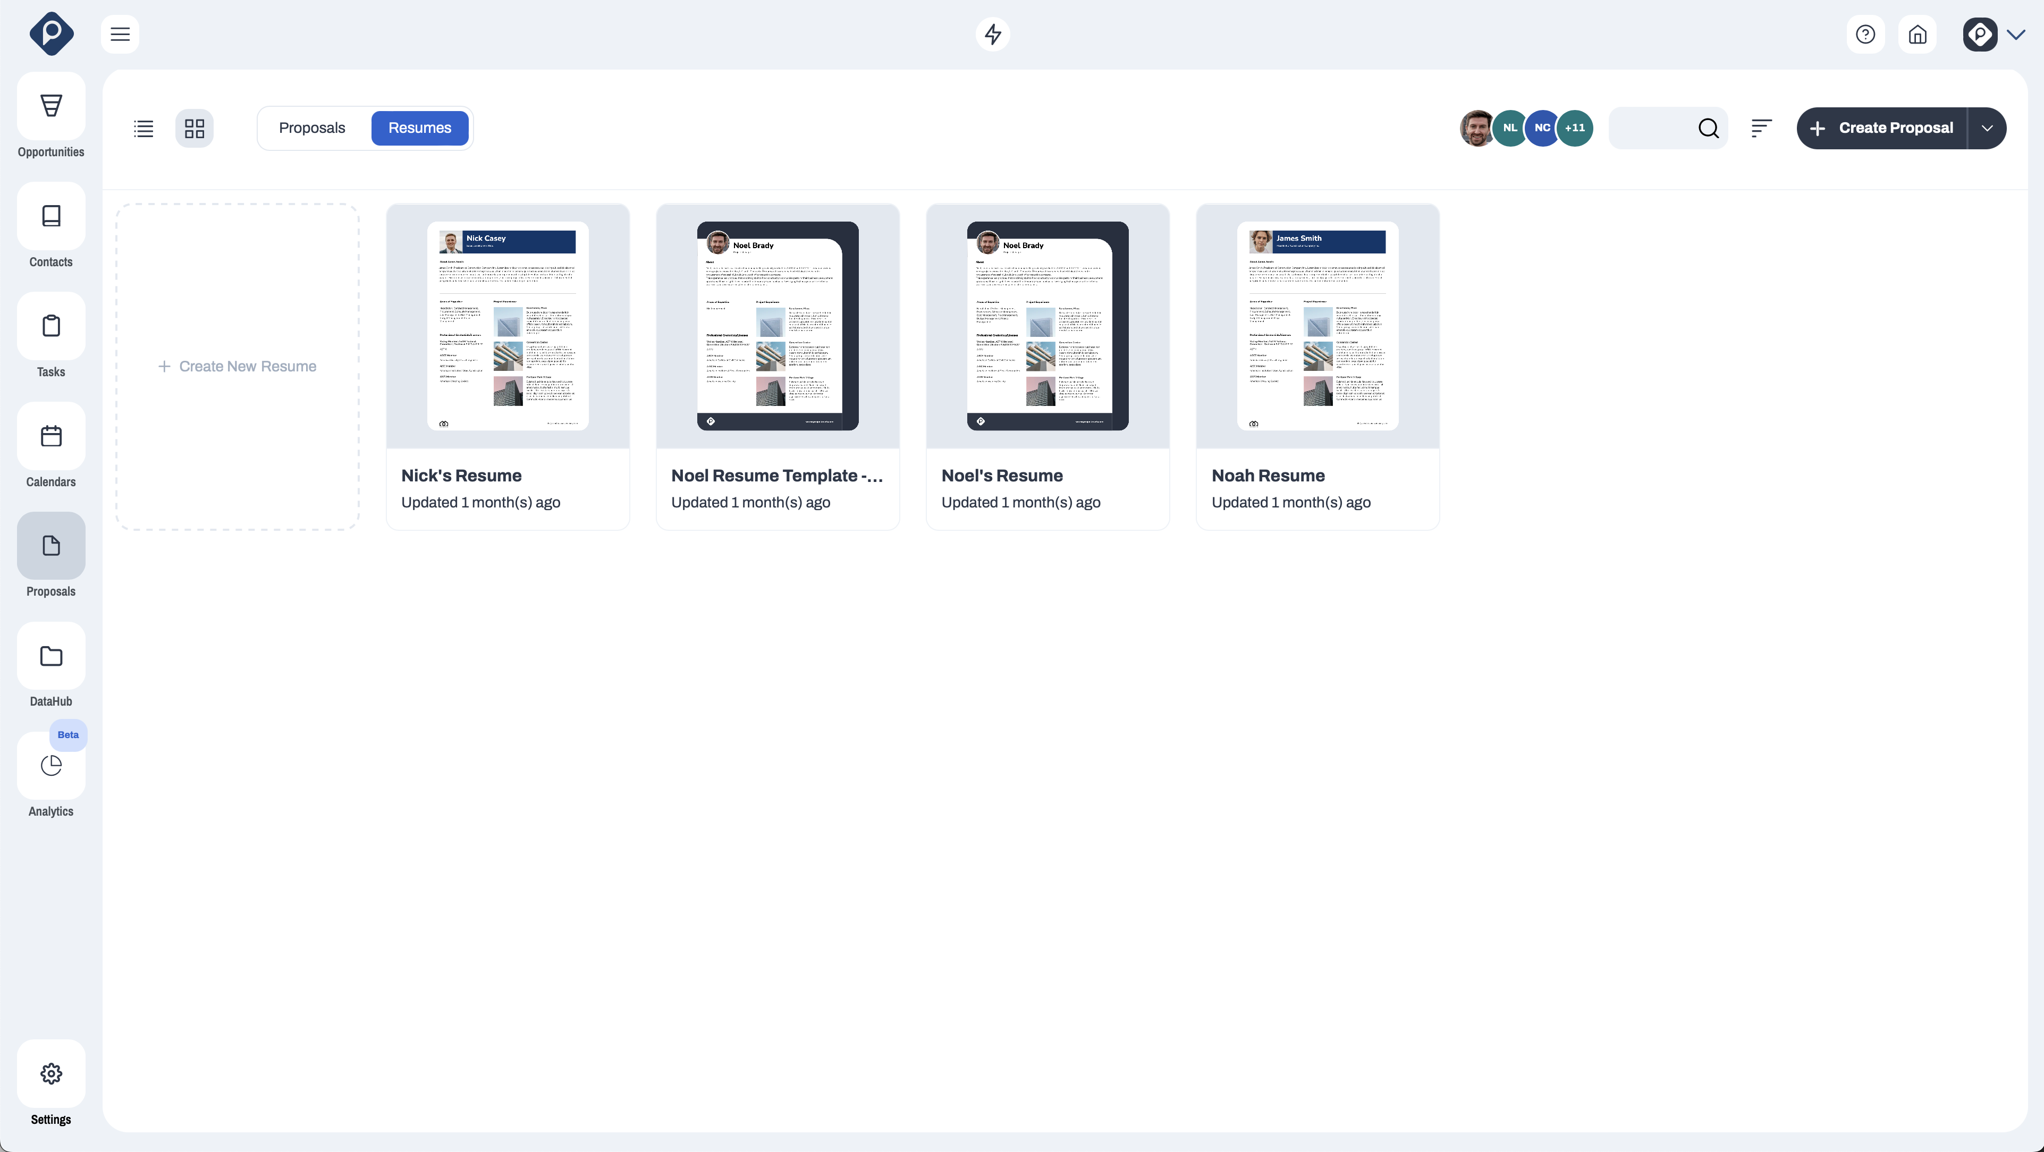
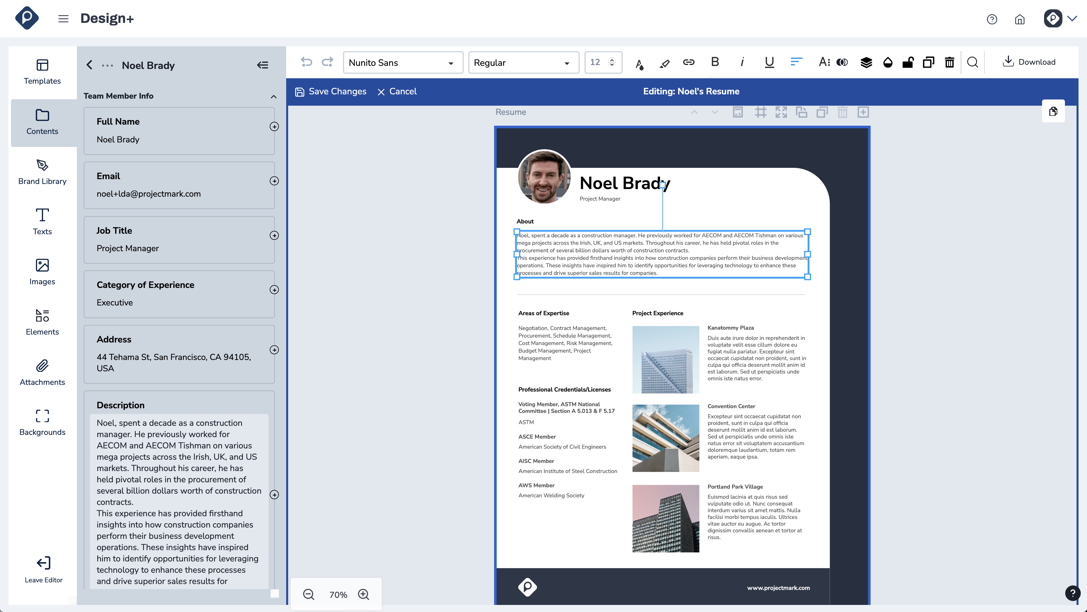
Team Resumes Management
Unlimited Resumes Creation
Unlimited Template Creation
Filter by Team Members
Multiple Resumes by Team Member
Easy Access to Members Info
Watch How To Video

Slide 18
Integrations

Slide 19
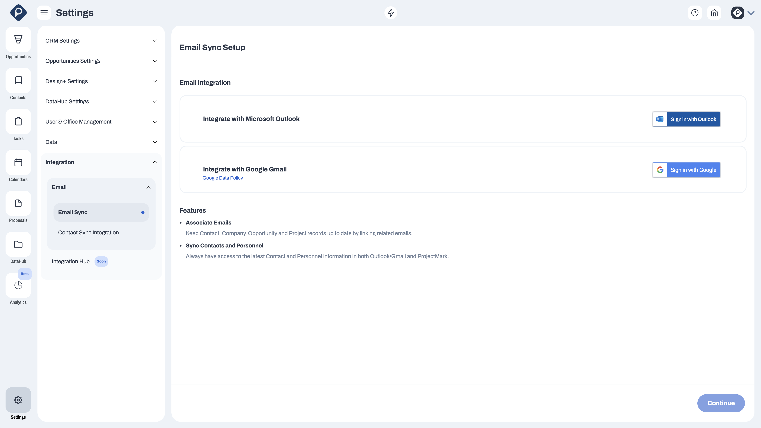
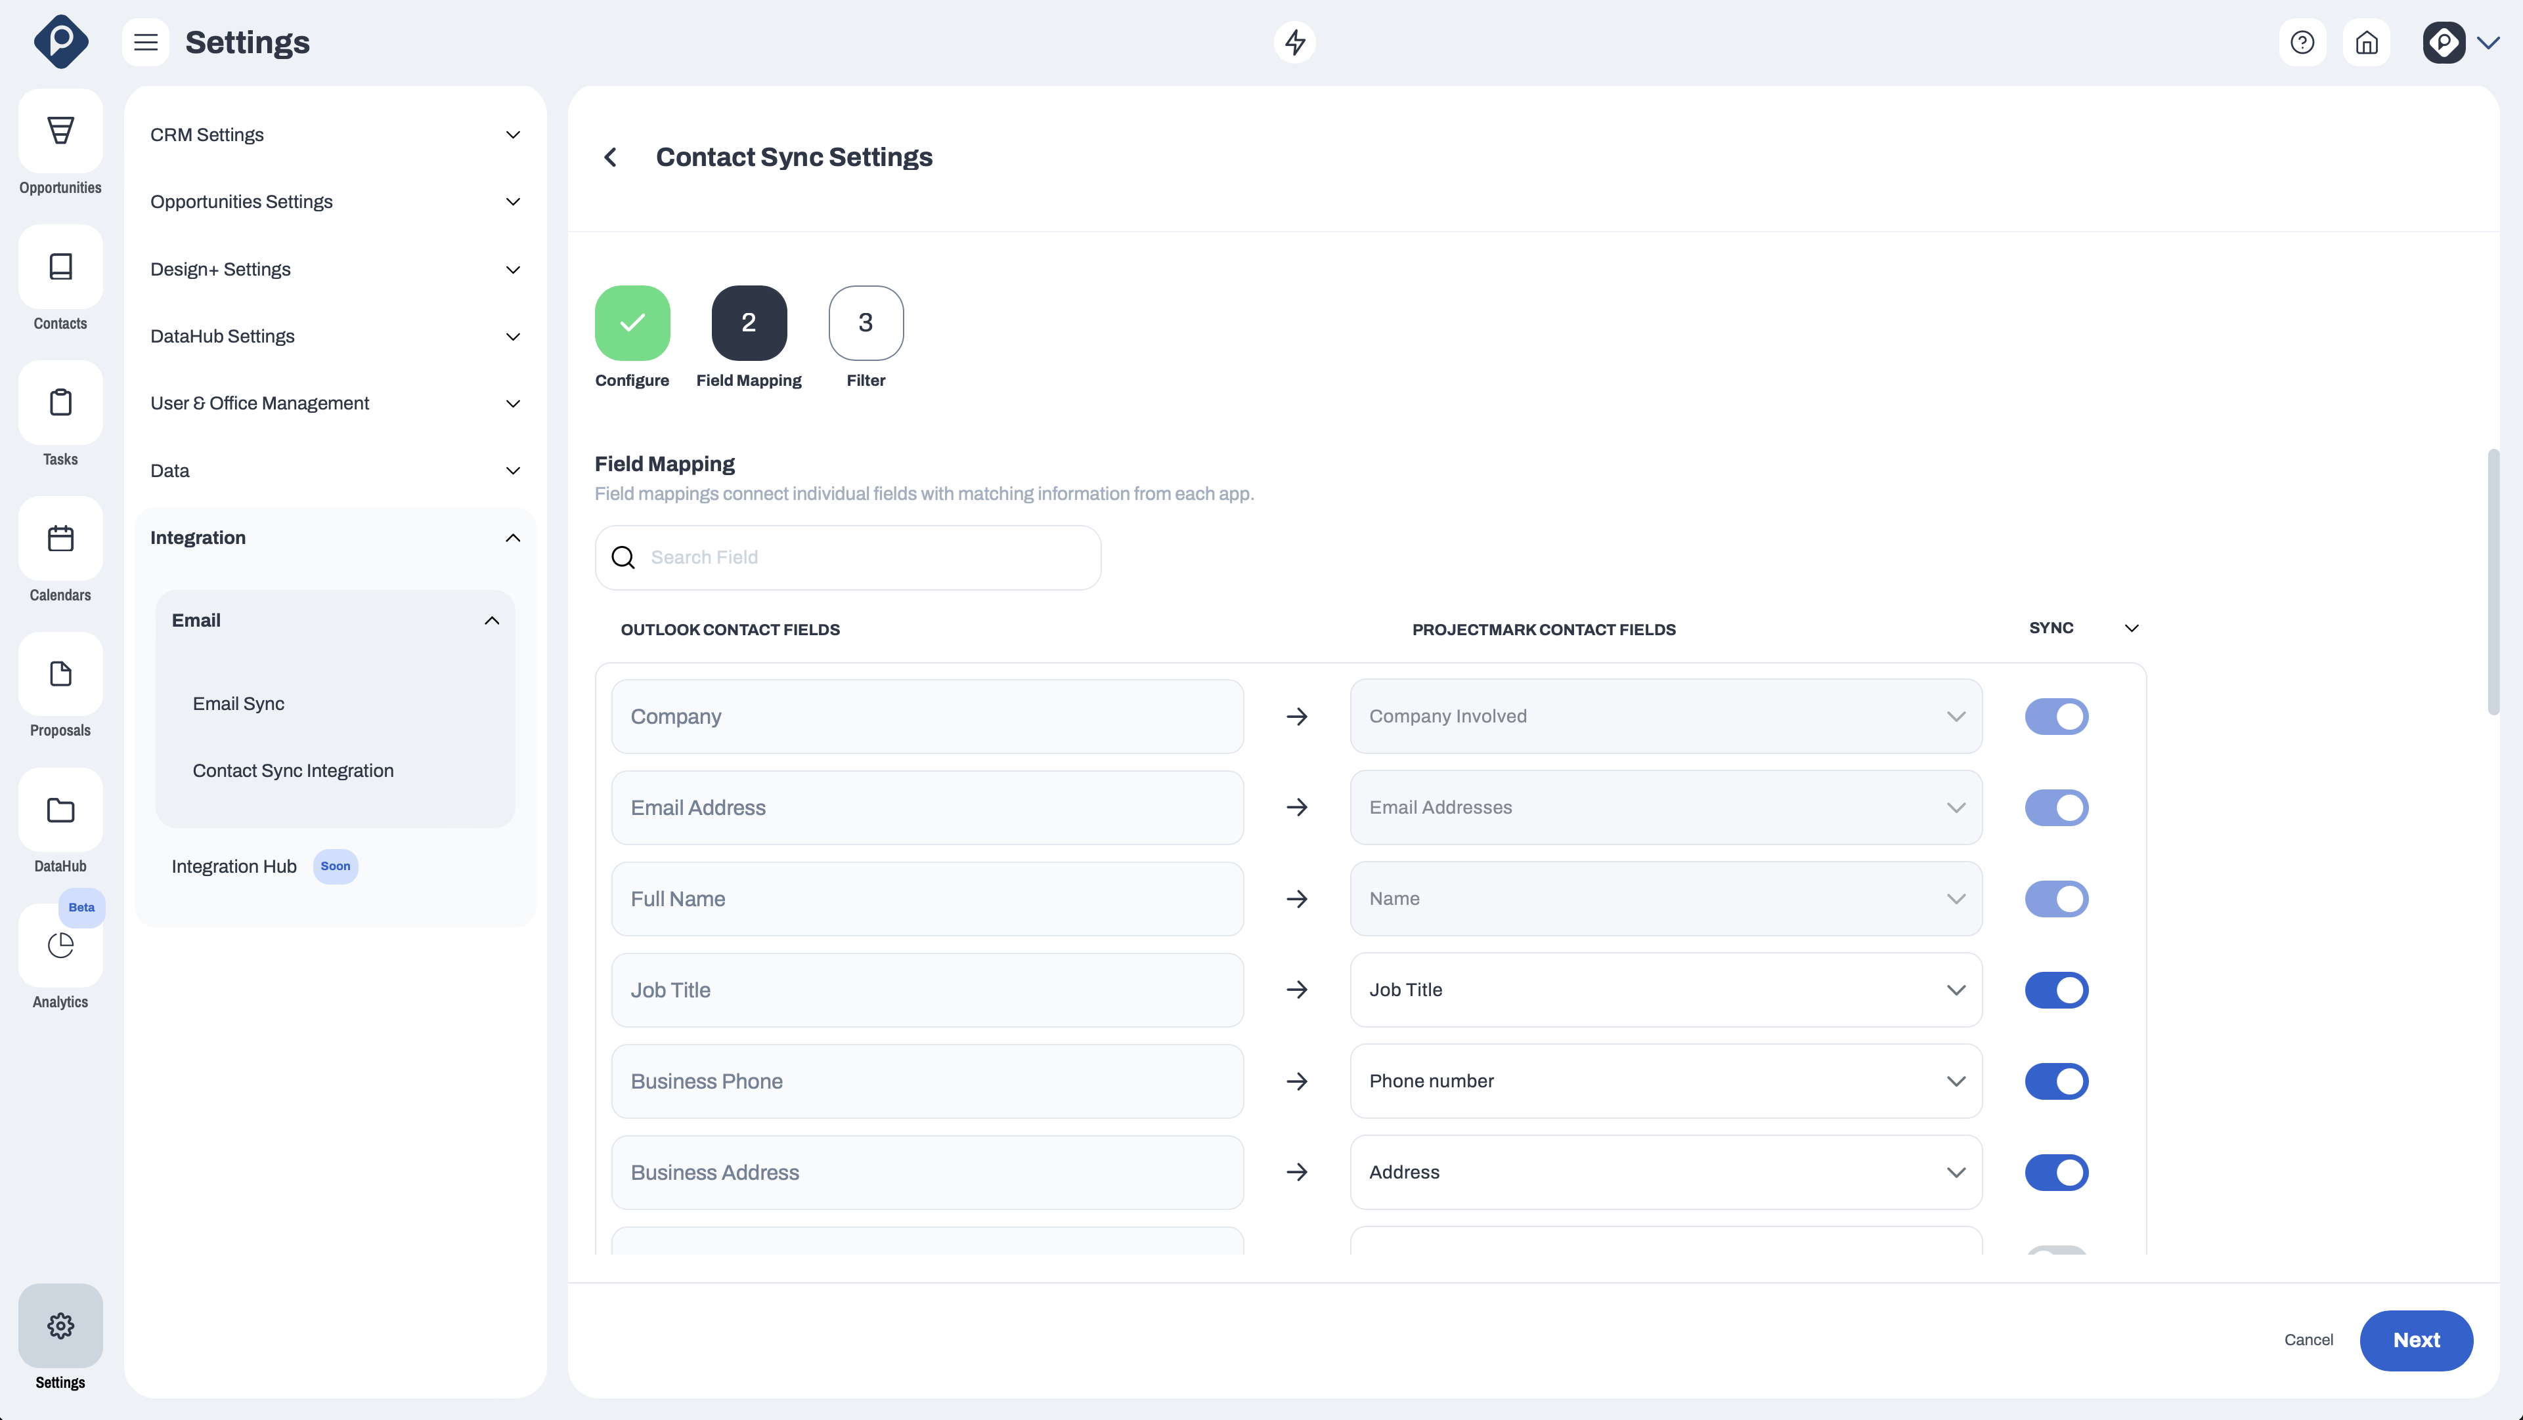
Outlook/Gmail
Effortlessly sync, configure, map, and filter contacts from both Outlook and Gmail directly to ProjectMark.
This integration empowers you to maintain a centralized hub for all your contacts, ensuring that your data is up-to-date and easily accessible within our platform.
We've also added the ability to add new contacts without an associated email address, so you can always have the correct contact no matter the circumstances.
Watch Video

Slide 20
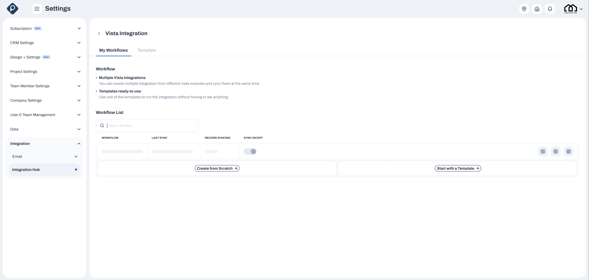
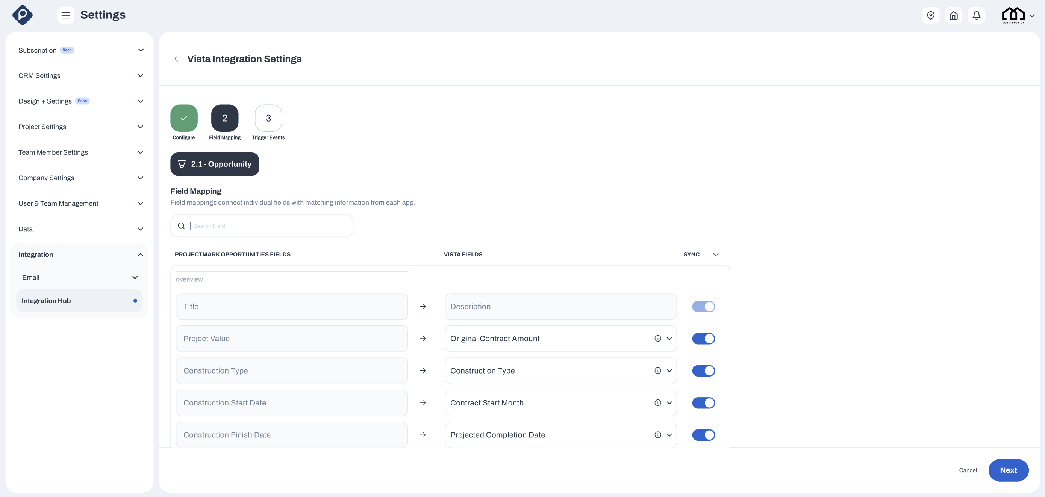
Vista Integration
Q4 RELEASE
The ProjectMark Connector for Vista will help you seamlessly gather and synchronize essential data across your Projects, Team Members, and Companies within Vista, minimizing the effort required on your end.
This integration ensures that your financial data and other critical information are kept up to date across multiple modules. It also ensures that your information is always current and accurate, enhancing your workflow and making data management effortless.
Watch Video

Slide 21
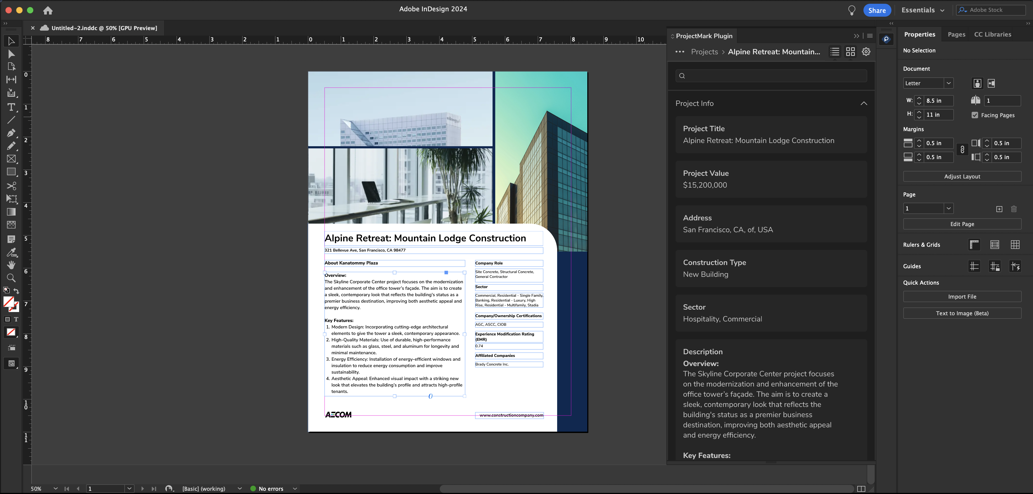
Adobe InDesign Plugin
Q4 RELEASE
Seamlessly access all your company, project, and team members' data directly within Adobe InDesign using the ProjectMark Plugin. This includes not only data but also all images and PDFs stored in ProjectMark DataHub, providing you with a comprehensive resource hub at your fingertips.
By linking images and PDFs rather than embedding them, you can ensure that your InDesign files remain lightweight and high-performing, allowing you to work more efficiently without compromising on quality or speed.
Watch Video

Slide 22
Implementation

Slide 23
CUSTOMER SUCCESS
Onboarding Process
To ensure successful implementation, ProjectMark follows a structured five-phase onboarding process for your company.
May 07, 2024
1
Data Received
“
2-4 days
Client has sent data and we are assessing
Excellent Customer Care and Systems Software"
2
Data Mapping
1-2 weeks
Mapping through inputs with client or lightly cleaning for upload
We love Project Mark! It is easy to use and specifically designed for Construction CRM tracking. They have fantastic customer care and are responsive and creative with our needs. We are very happy with the integration process, Morgan has been an amazing account rep!
3
Data In
1-2 weeks
First iteration of data has been uploaded and is being ‘tested’
4
QA Rounds
1 week
QA’ing in meetings with clients & making live adjustments
5
Onboarding Wrap Up
3-5 days
Finish up and send Implementation Success Survey
Stacie Ramos

